Slide 1
Statistics & Bioinformatics
Joe Parker

Slide 2
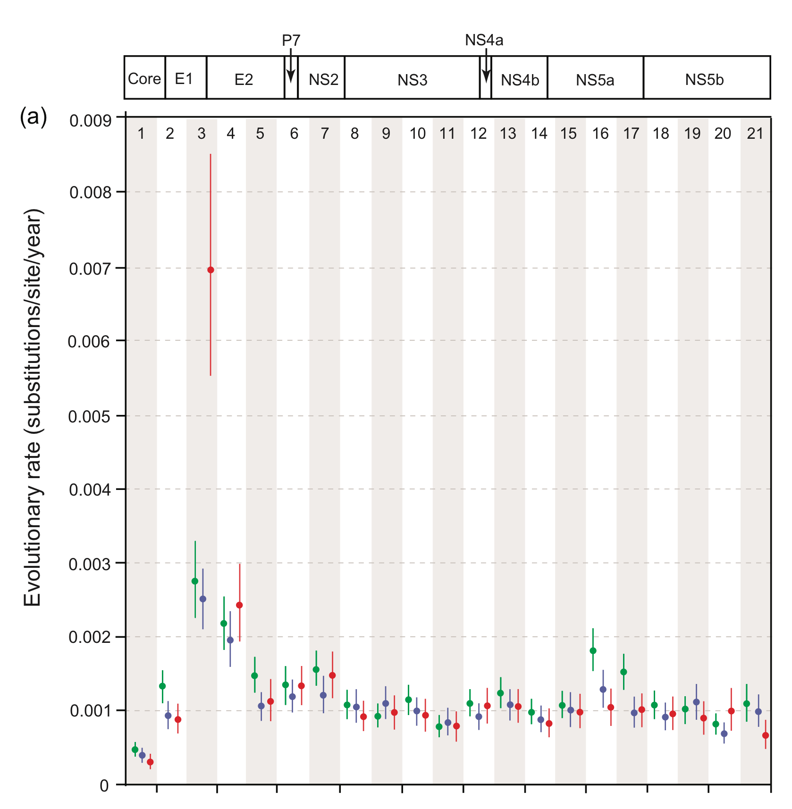
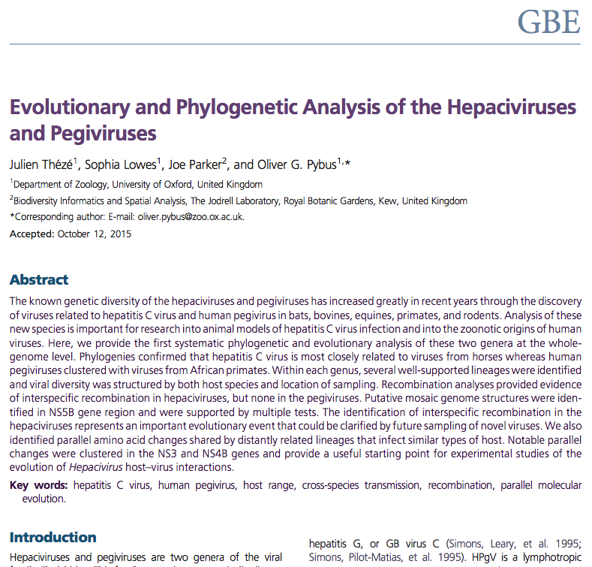
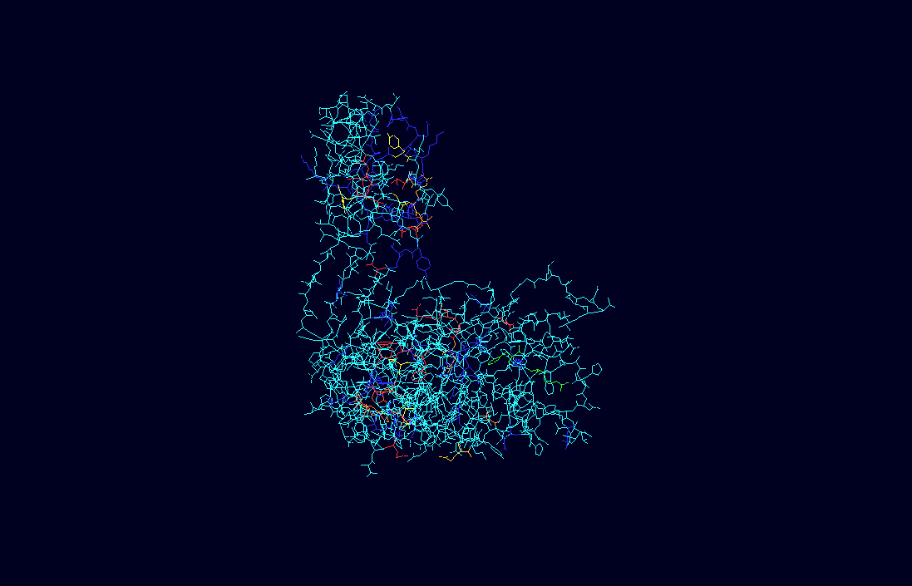
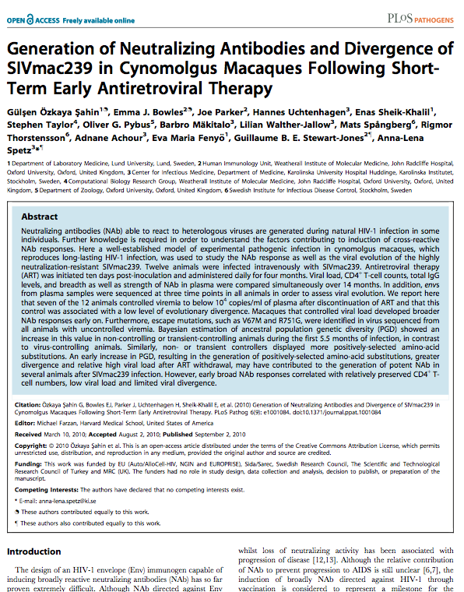
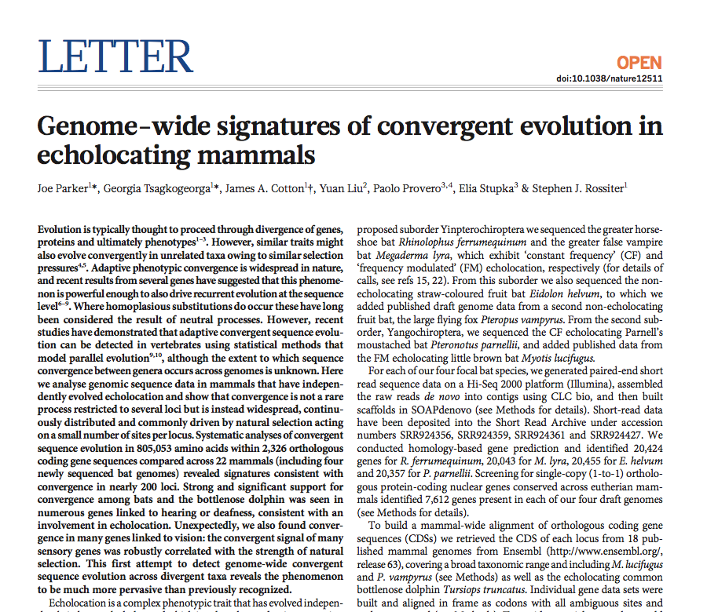
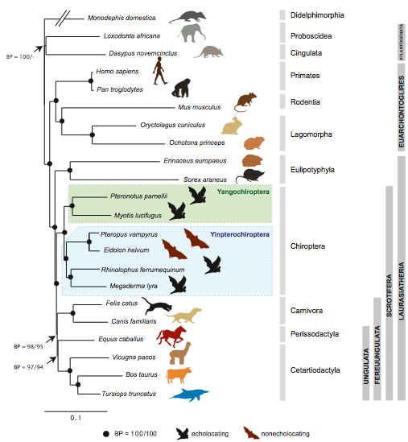
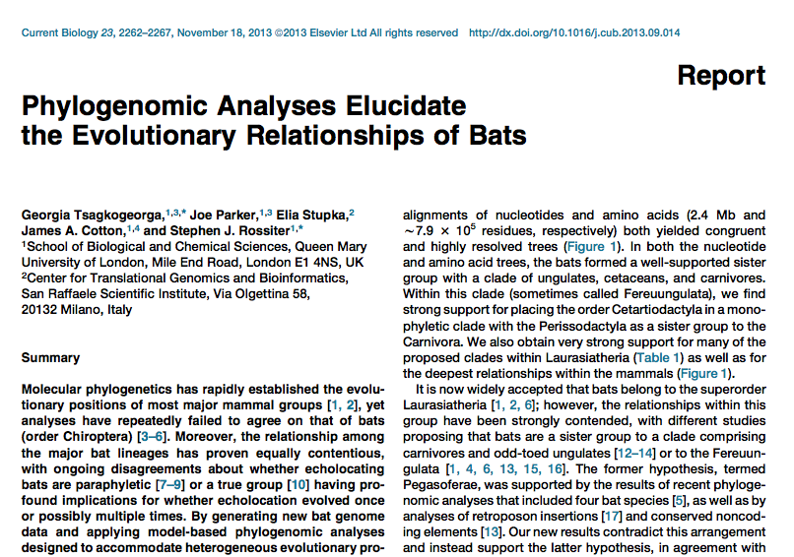

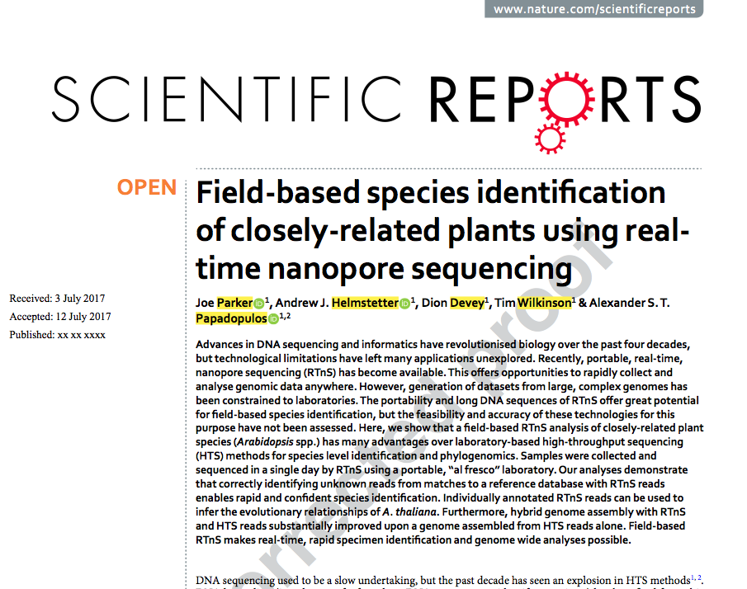
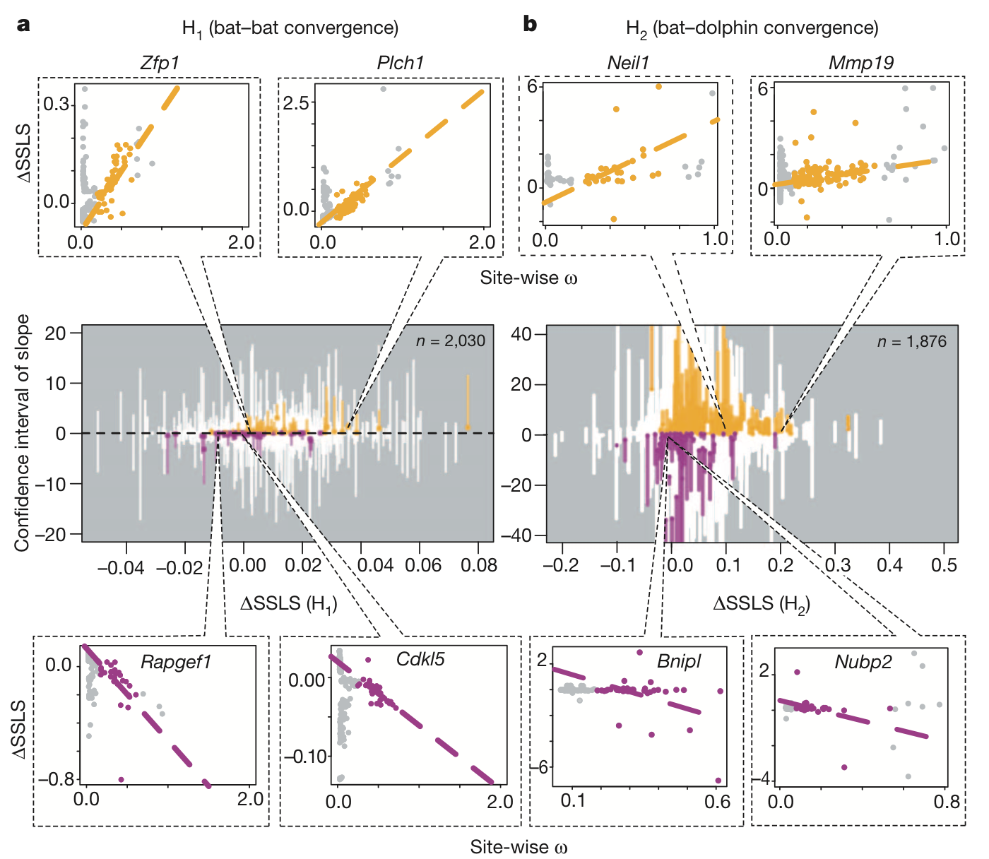
Joe Parker - background
VL 4 length
≤ 34
≤ 27
Neut -
Neut +
VL 1 length
> 34
> 27
Average

Slide 3
Goals
Equip you to be a bioinformatician
(in a statistical sense)
That’s it

Slide 4
Assessment

Slide 5
What do we do?
Collect empirical observations of phenomena
Spot patterns
Propose models that explain them
Simulate guesses according to the models
Compare them, refine, repeat
… SCIENCE

Slide 6
Bioinformatics and stats
Toolbox: big data, replicates, moar
Concepts: statistics, probability, populations
Techniques: multivariate analyses, programming, genomics

Slide 7
NOT
Stats 101
Programming course
Mol. Biol.
Genomics
Machine-learning / AI / any advanced stuff

Slide 8
Roadmap

Slide 9
Populations, probability and statistics
Almost all biological phenomena vary continuously
Probability: assess outcome given model
Equally, for a large N how many X?
How likely is X?
Statistics:
How likely is it that X occurs by chance?
By some mode?
From same distribution (process) as Y?

Slide 10
The P-value
It isn’t: magic
Working definition: probability of seeing a value as or more extreme than the observed, assuming model, parameters
“Is this result random?” (ahem)

Slide 11
Descriptive stats
Count
Mean, mode, median
Range
Confidence intervals

Slide 12
Applications
Trees on h {R}. Two species or one?
k nonsynonymous changes of N aa replacements. Convergent?
913 patients with cancer, 50,000 SNPs, 2031 haplotypes. Will patient X get cancer?

Slide 13
Introduction to R
Joe Parker (Rob Knell)

Slide 14
What is R?
Open source statistical programming language
Based on a commercial language called “S”
Powerful and flexible software that can do any statistical analysis you can think of and much more

Slide 15
What can I do with R?
With the base R installation you can carry out a tremendous variety of statistical analyses
You can draw publication-quality graphs
With add-on packages you can do just about anything

Slide 16
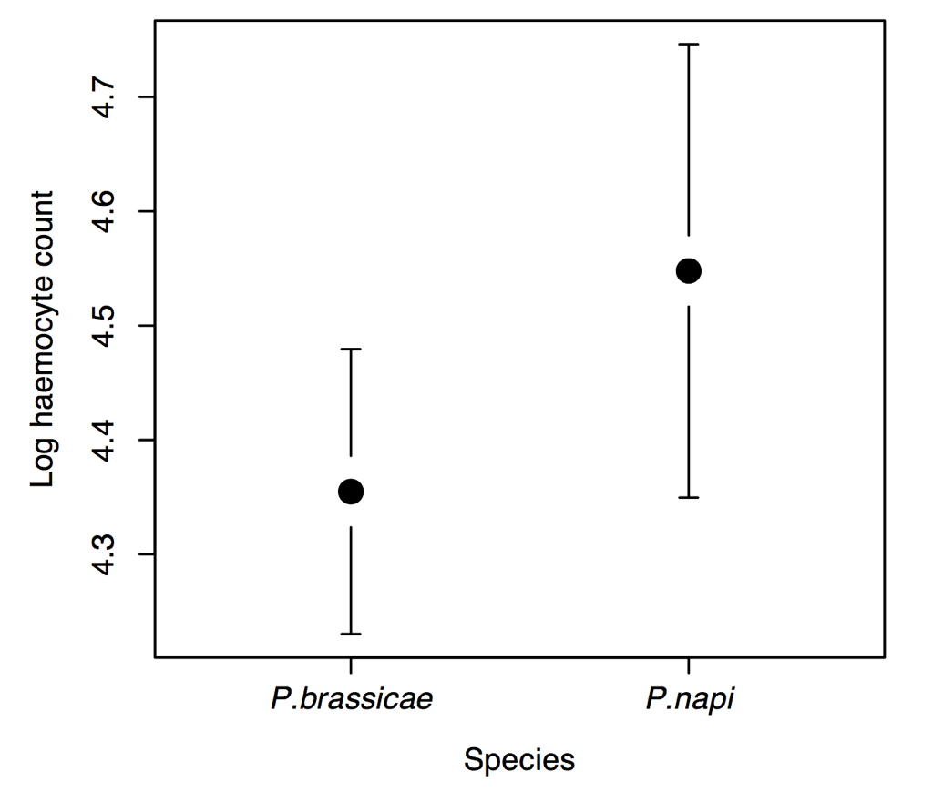
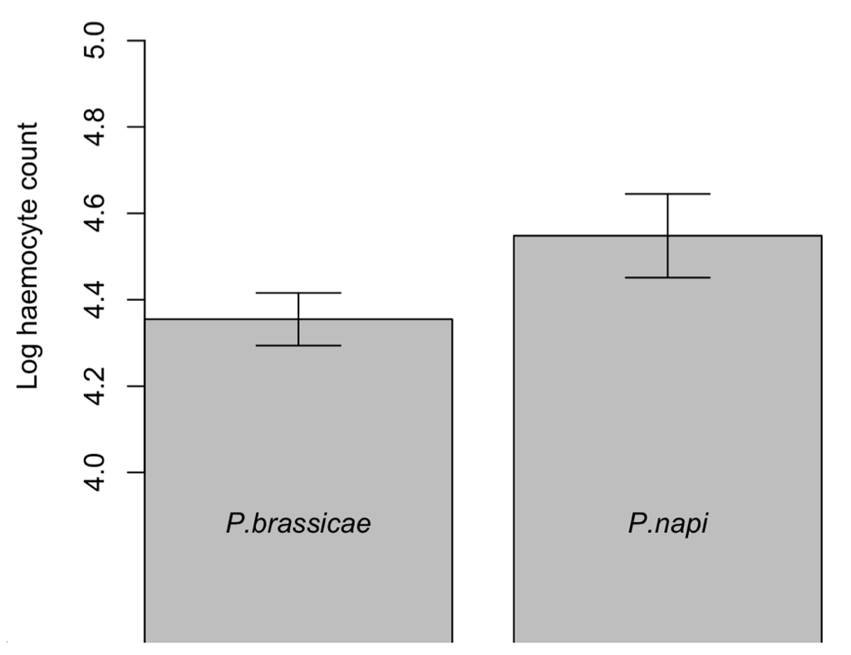
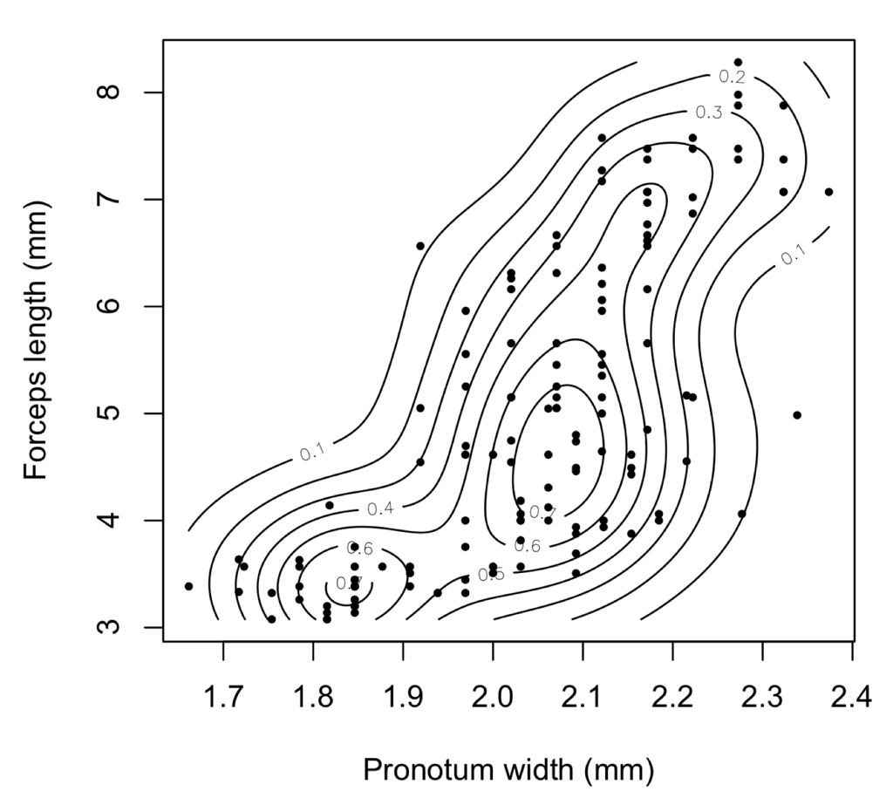

Slide 17
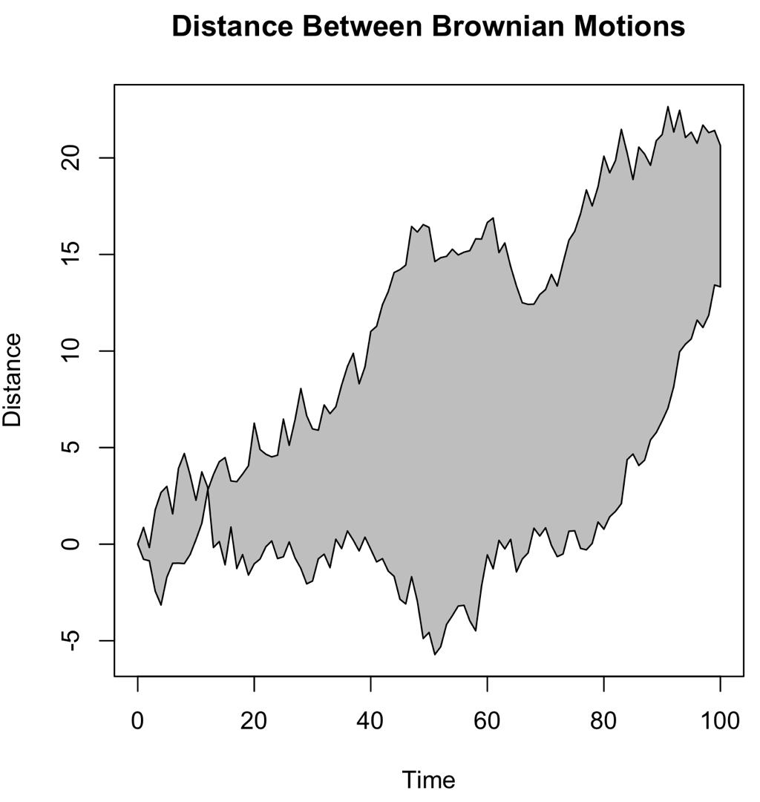
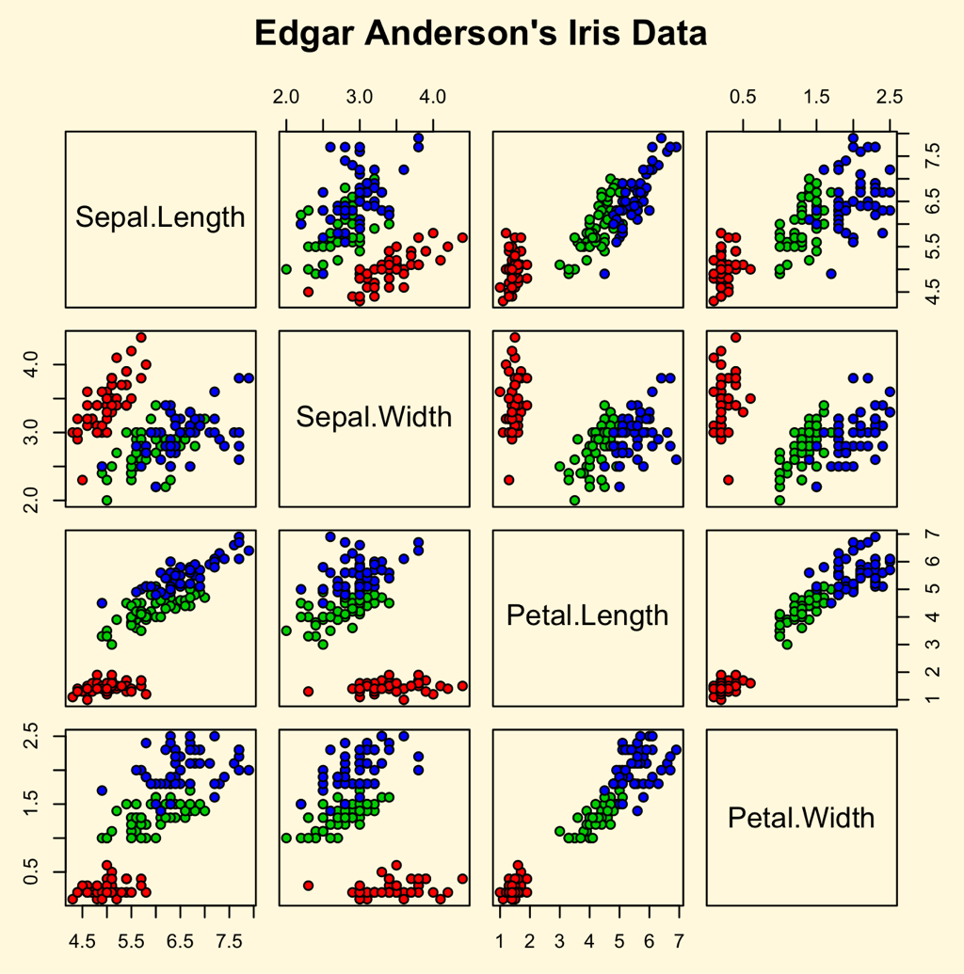

Slide 18
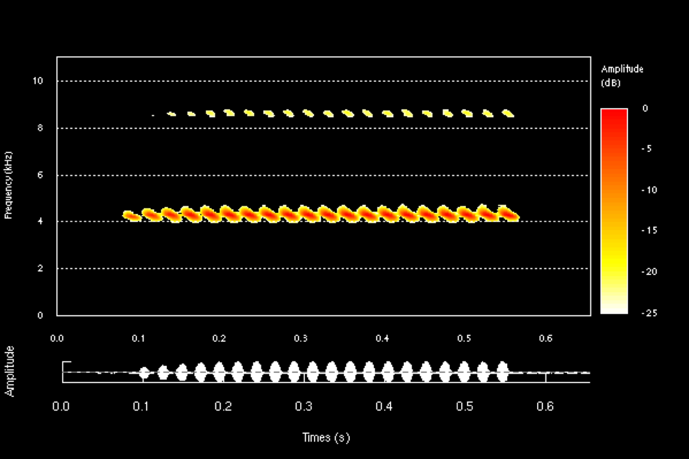
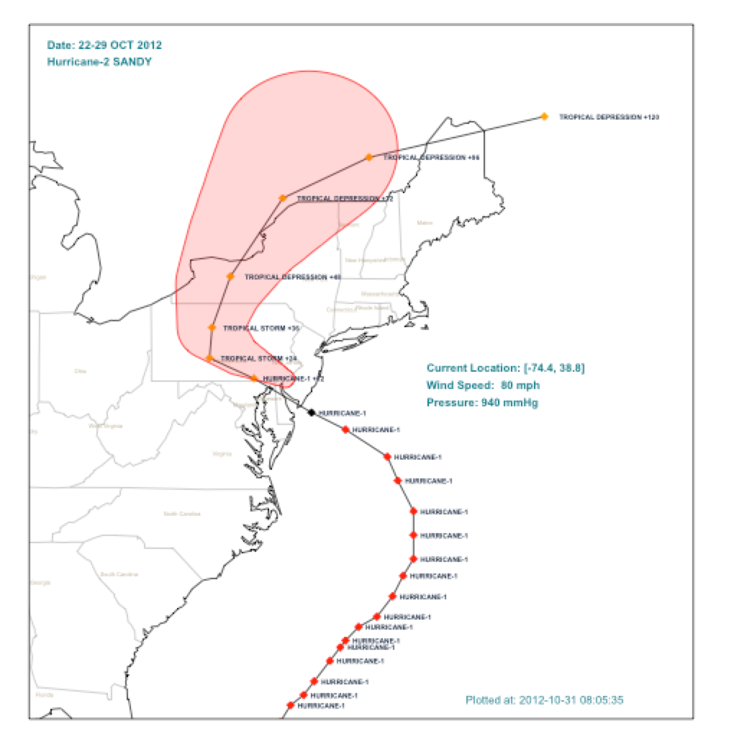
Sonogram of cricket song
Hurricane Sandy predicted path

Slide 19
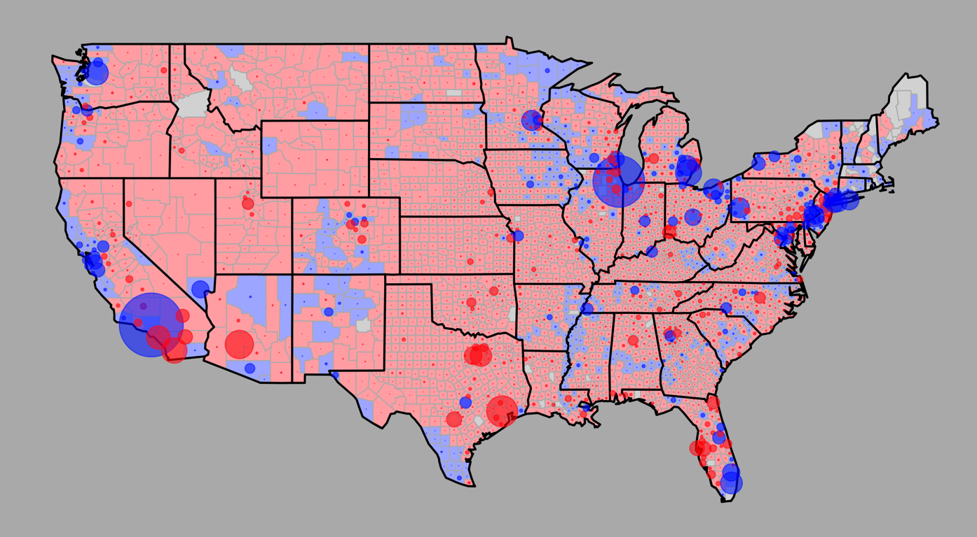
US Presidential election map

Slide 20
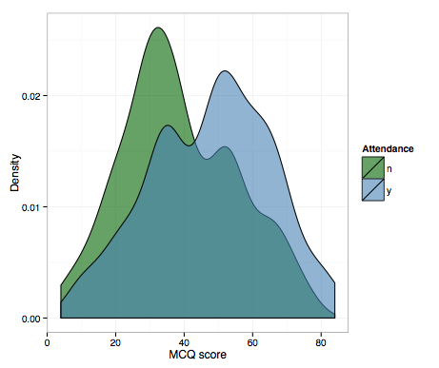

Slide 21
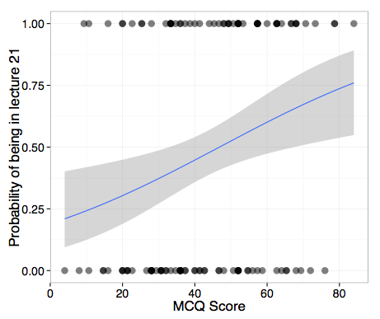

Slide 22
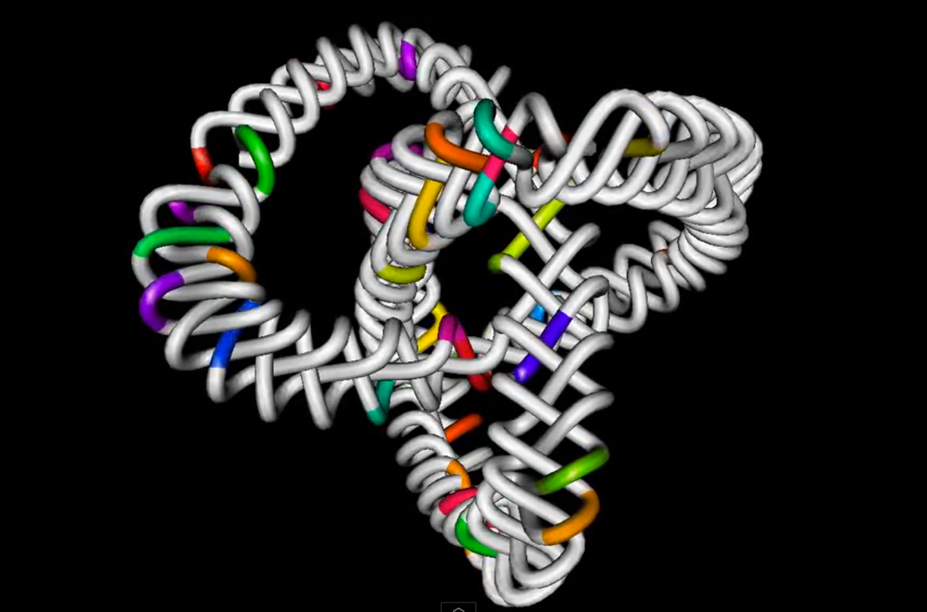

rgl package

Slide 23
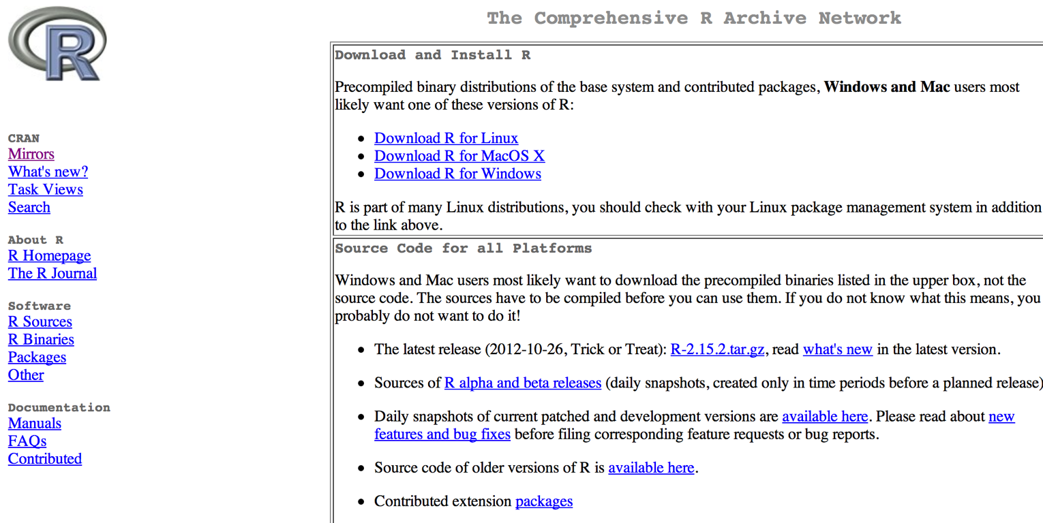
How to get R
cran.r-project.org

Slide 24
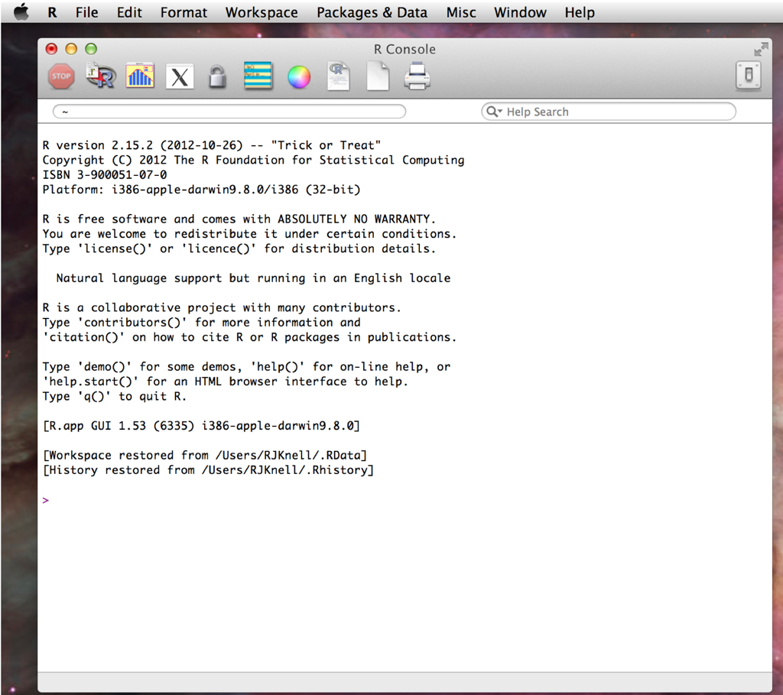
R basics
R console open on a Mac

Slide 25
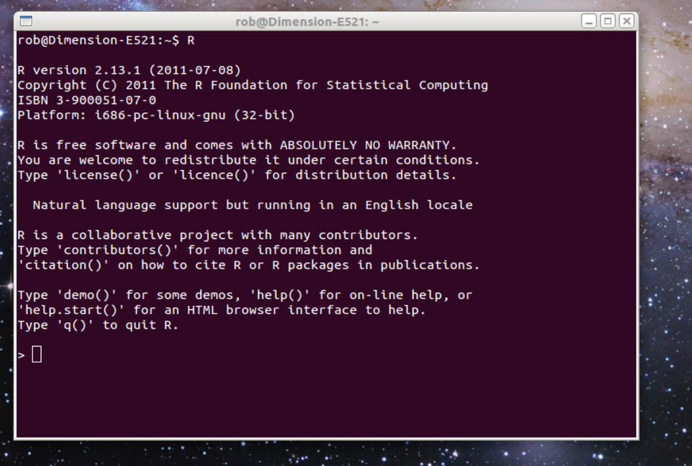
R basics
R in a terminal window on a Linux machine

Slide 26
Command line software
You type an expression or instruction at the command prompt and press “enter”
If R can understand what you’ve typed, it’ll do what you’ve asked...
...or what it thinks you’ve asked: unlike Python, R contains some fairly high-level functions

Slide 27
Data exploration and description

Slide 28
Exploratory data analysis
Gain an understanding of the nature of the data
Get clues regarding the relationships between variables
Detect errors
Know which analyses might be necessary
Generate hypotheses (maybe)

Slide 29
Exploratory data analysis
Numerical and graphical descriptions of data
Need to revise some basic numerical descriptives before moving on to graphical techniques

Slide 30
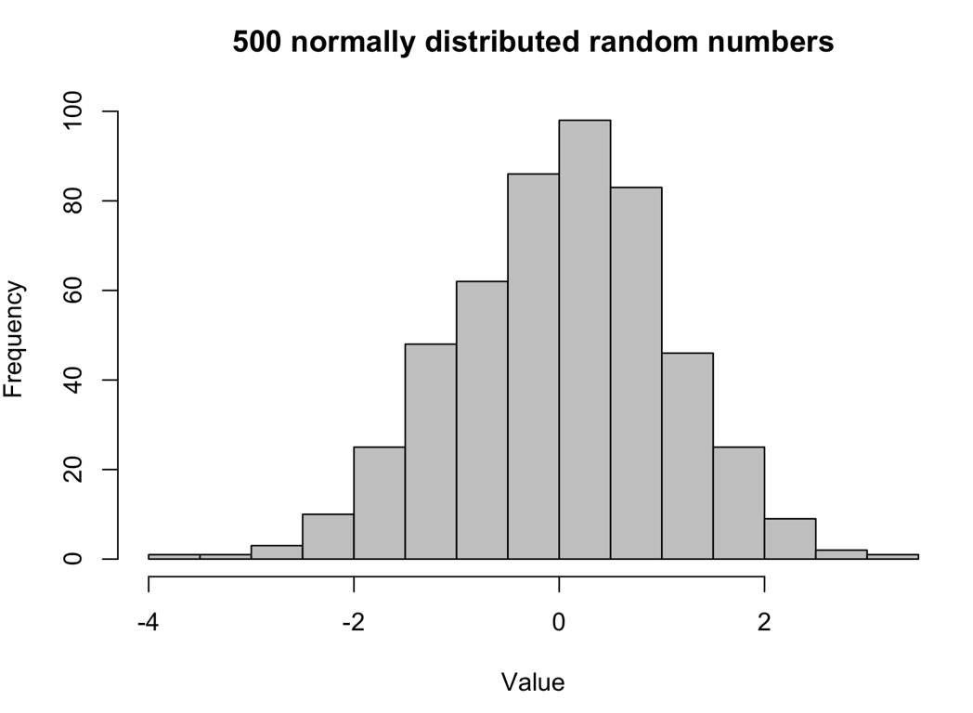
Frequency distributions

Slide 31
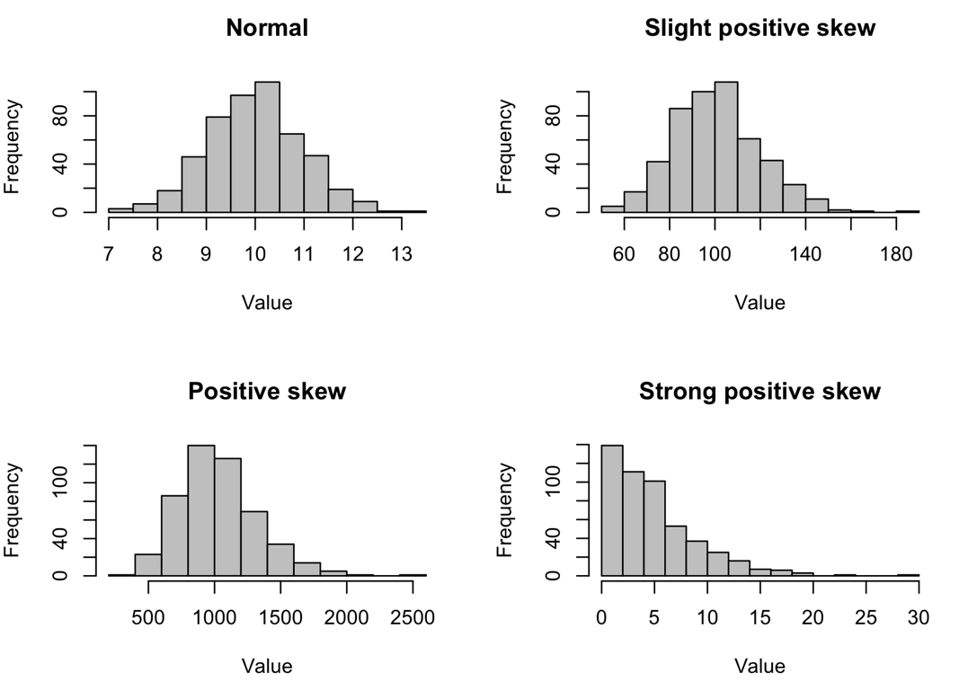
Frequency distributions

Slide 32
Descriptive statistics
Measures of central tendency
Mean, median, mode
Measures of dispersion
Standard deviation, variance, IQR

Slide 33
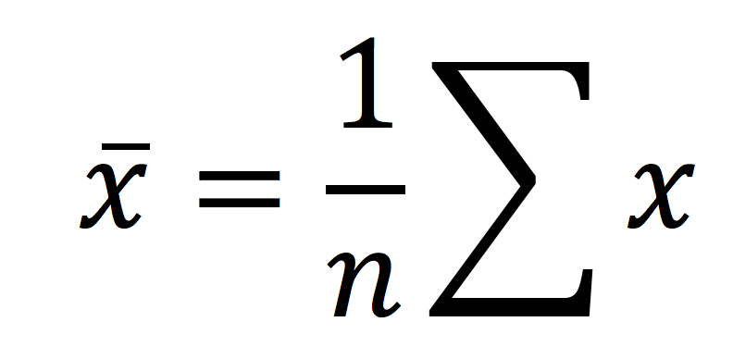
Central tendency
Mean
Median: rank data, take middle value. If even number of data take the average of the two middle values
Mode: most common value

Slide 34
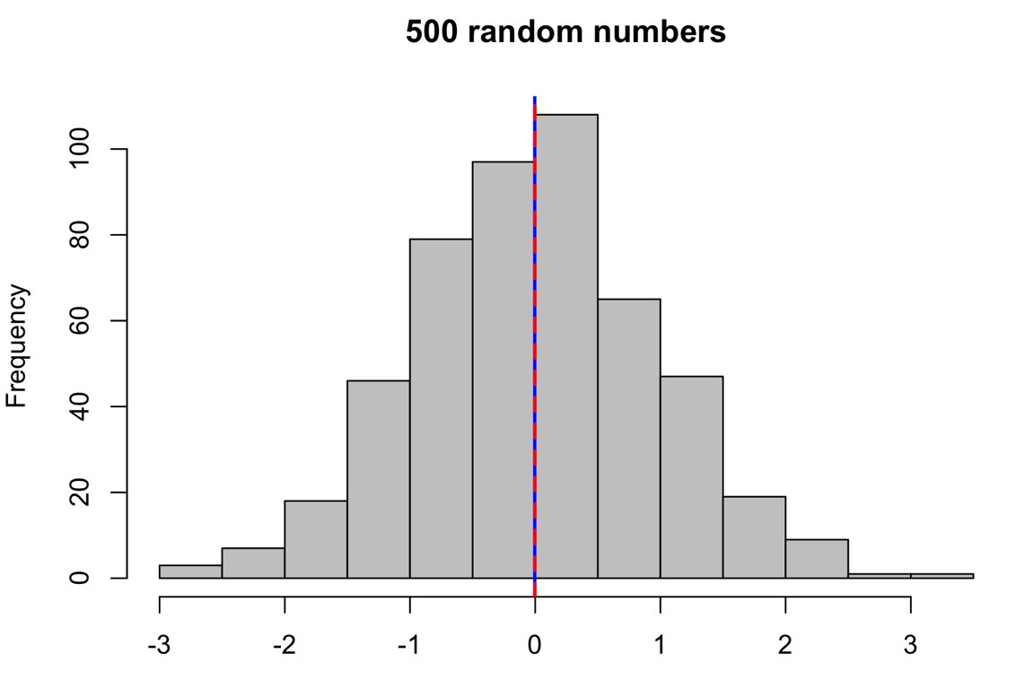
Central tendency
For normally distributed data, mean (blue) = median (red) = mode

Slide 35
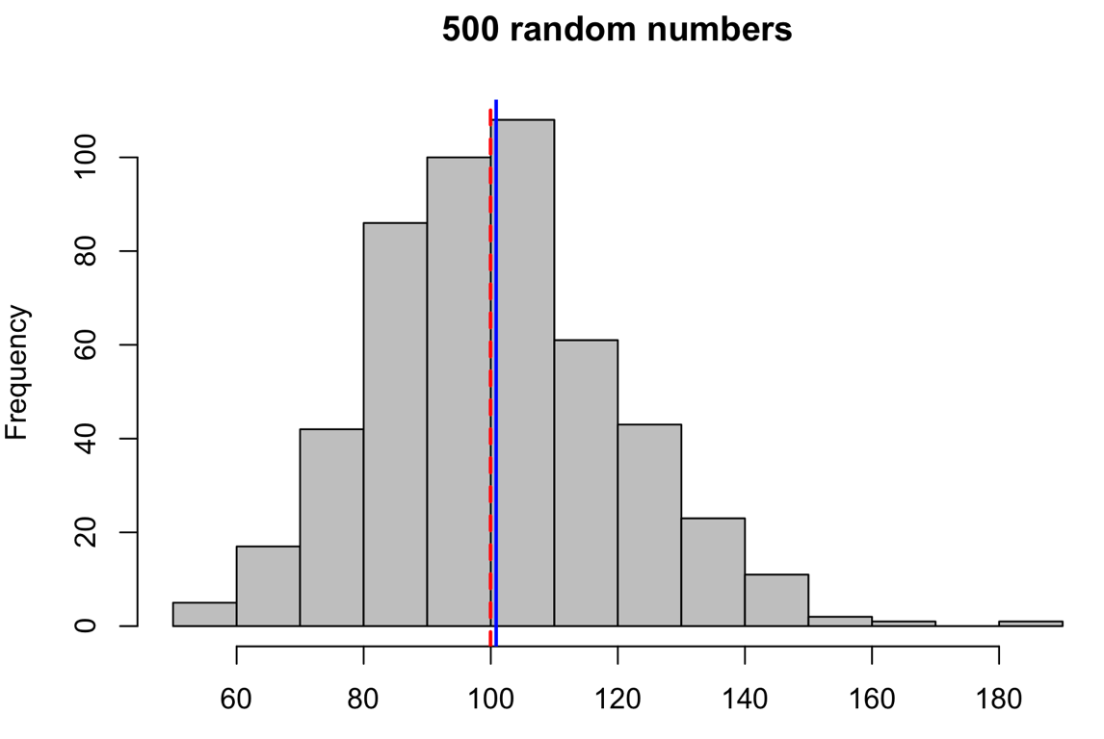
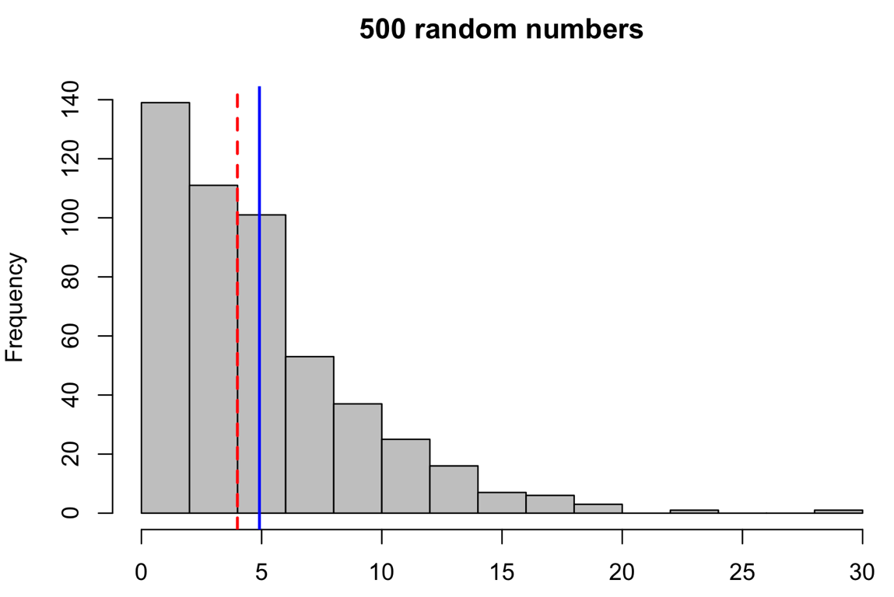
Central tendency
As the distribution gets more skewed, the mean, mode and median become less similar

Slide 36
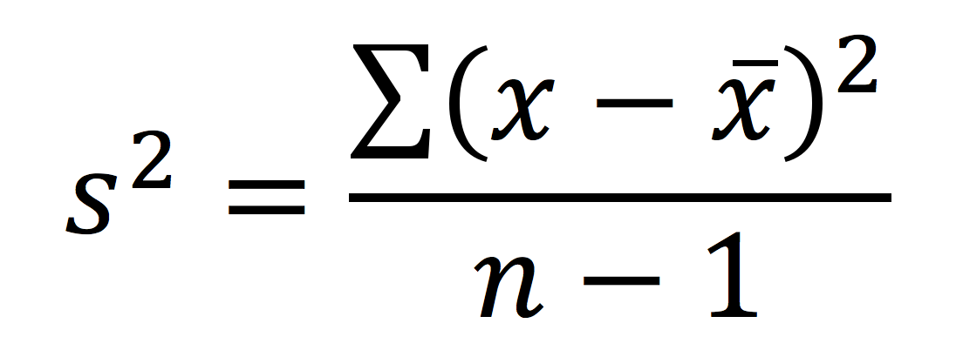
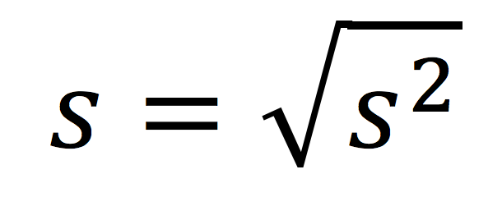
Measures of dispersion
Variance
Standard deviation
Range from 1st quartile (top of lower 25%) to third quartile (top of lower 75% of data): central 50% of data
Inter-quartile range (IQR)

Slide 37
Graphics for exploratory analysis: univariate data
Histograms
Boxplots

Slide 38
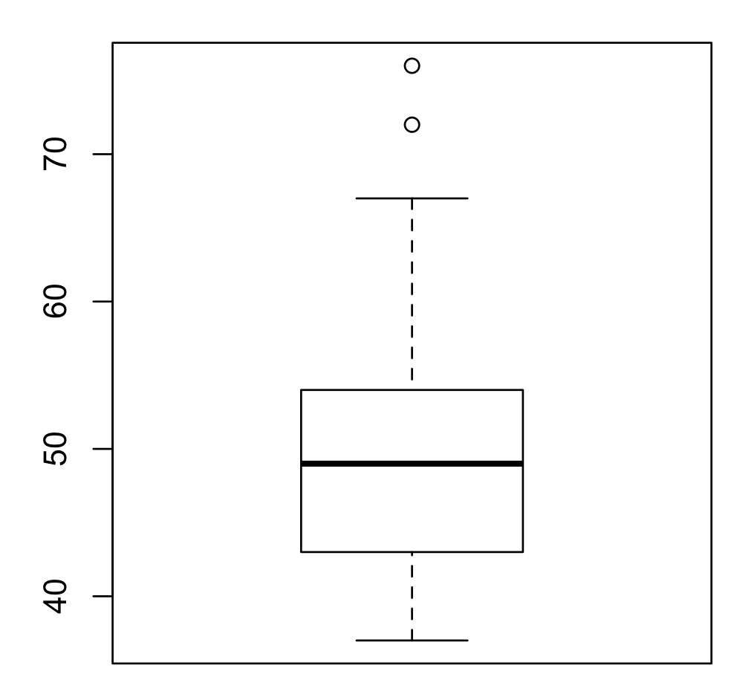
Boxplot
Outliers
Most extreme point <=1.5%
IQR from 3rd quartile
3rd quartile
Median
1st quartile

Slide 39
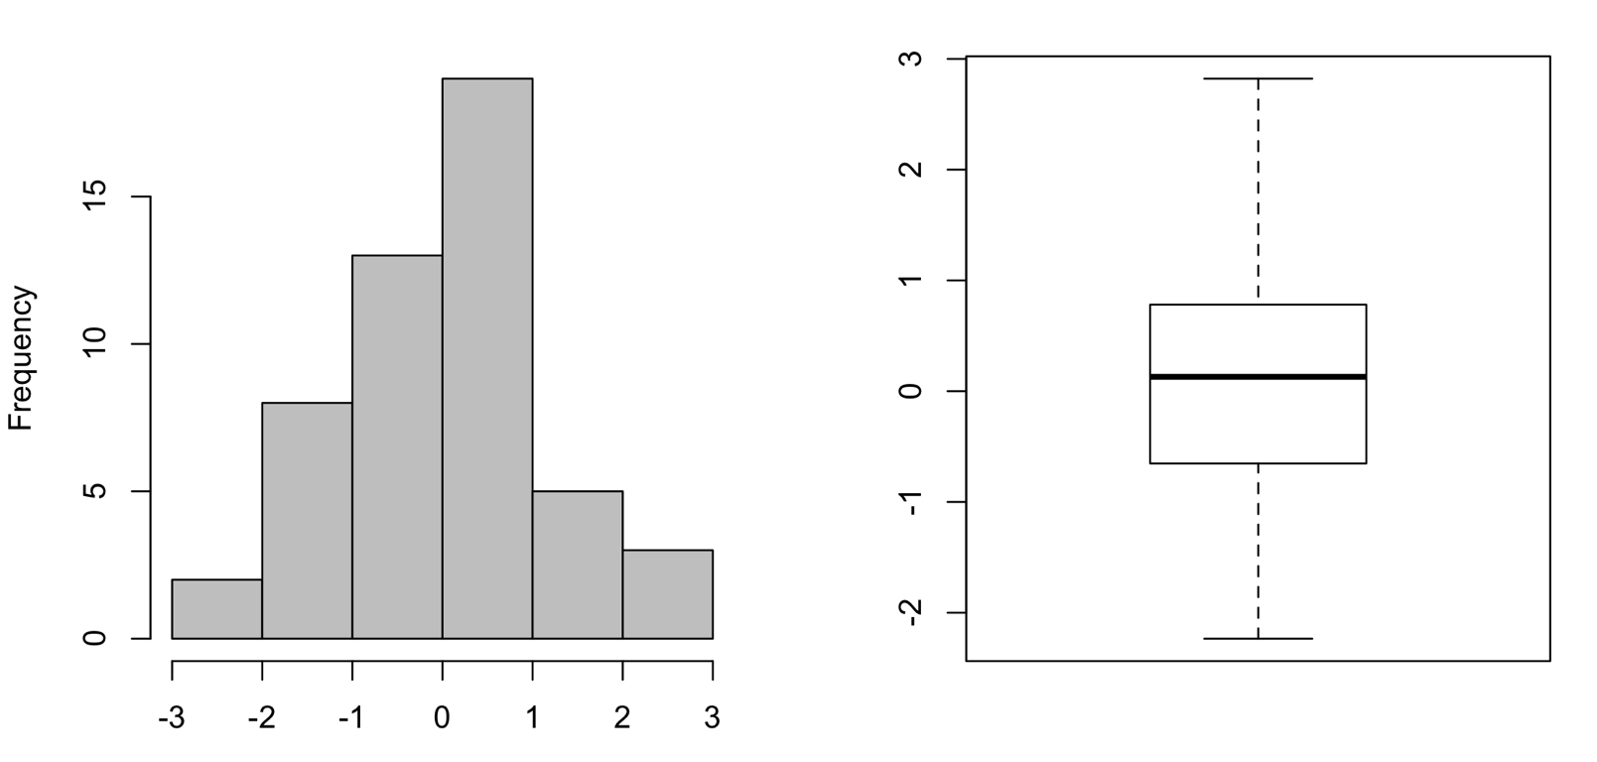
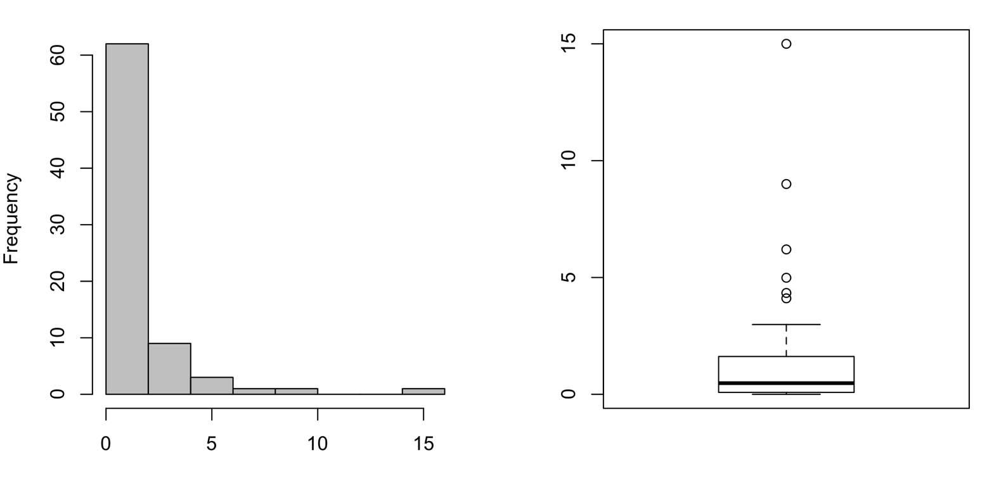
Using histograms and boxplots

Slide 40
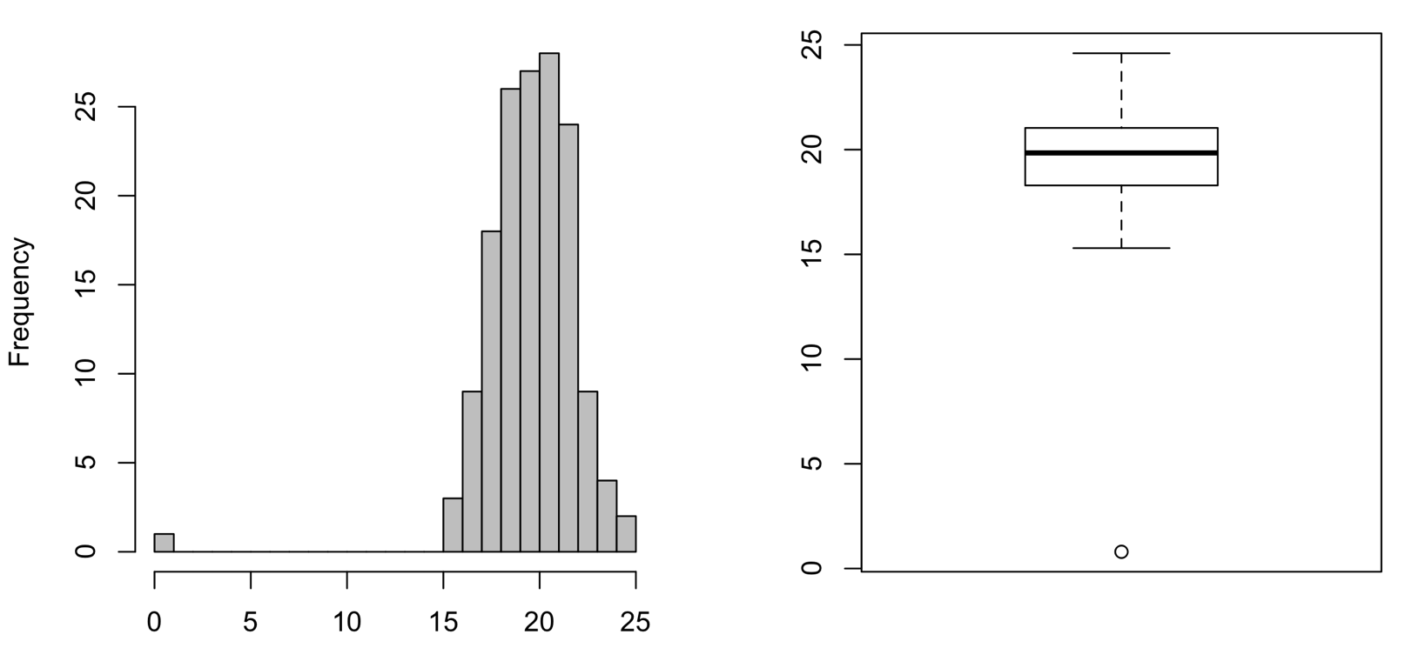
Using histograms and boxplots

Slide 41
Univariate data
Using exploratory stem-and-leaf plots, histograms and boxplots can:
Tell us about the shape of the frequency distribution
Help us identify outliers
Help us identify possible errors

Slide 42
Graphics for exploratory analysis: bivariate data
Scatter plots: use with two continuous variables
Stripplots and boxplots: use with one continuous variable and one categorical variable
Barplots: use with frequency data

Slide 43
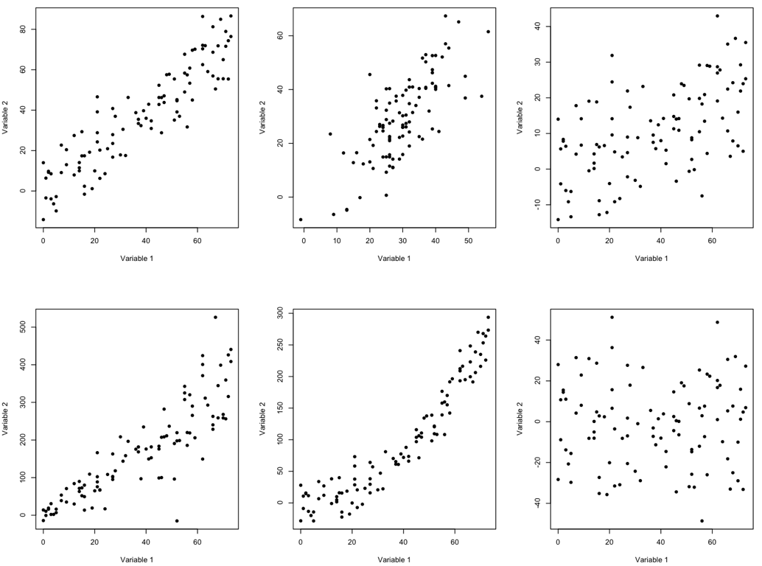
Scatter plots

Slide 44
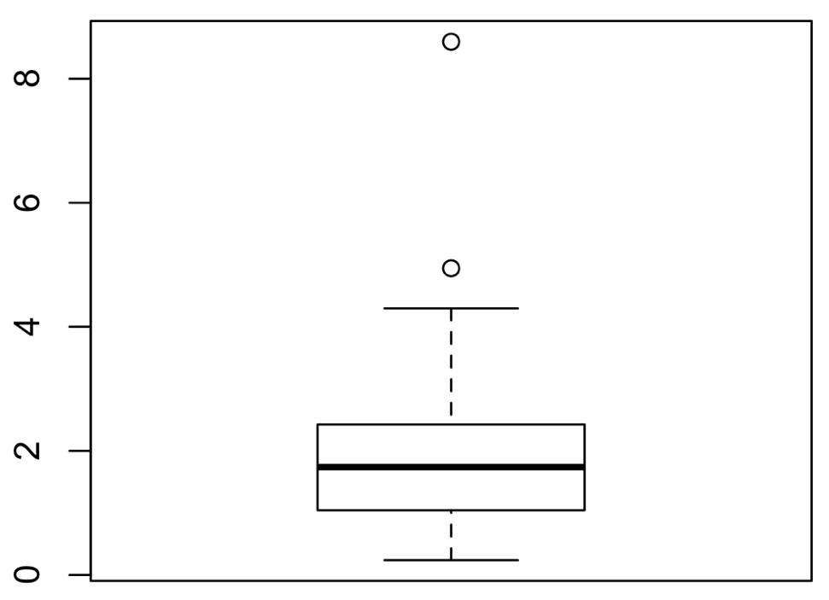
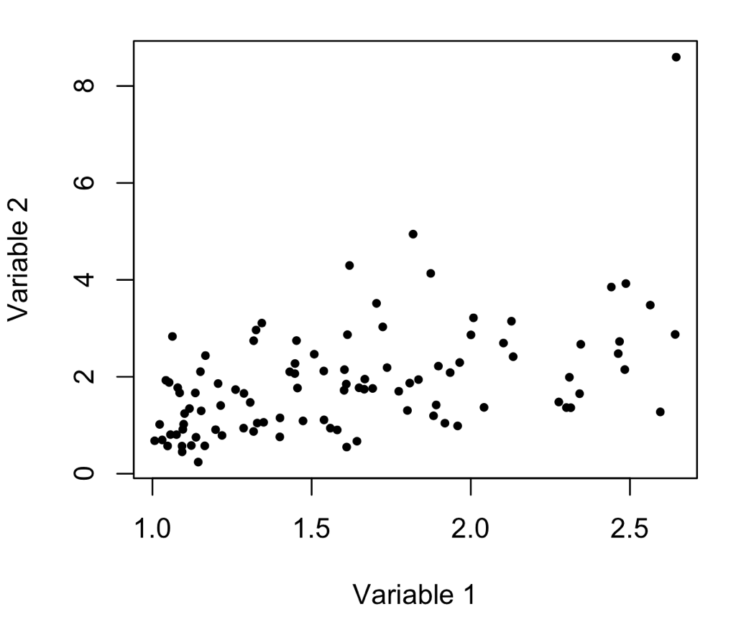
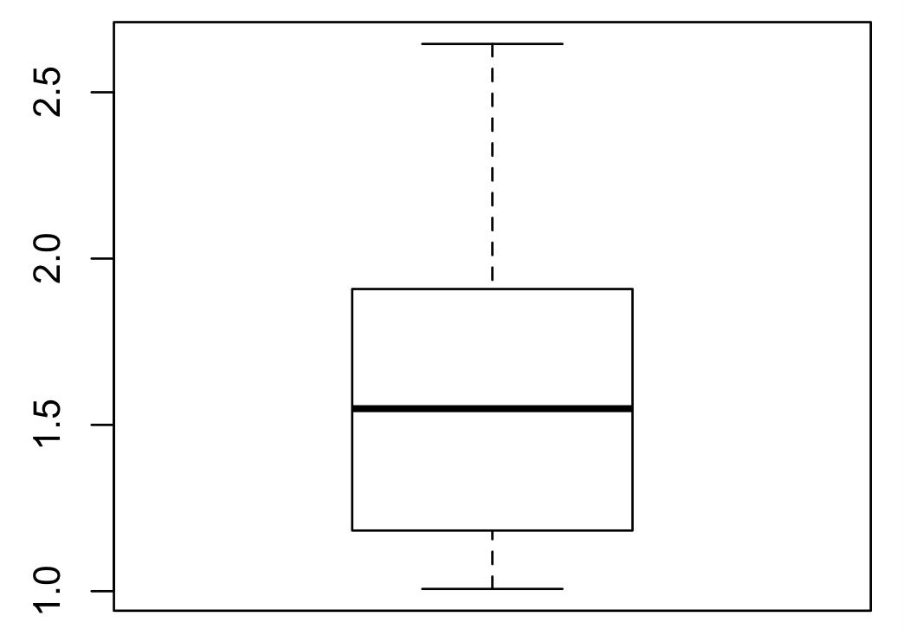
Scatter plots
Variable 2
Variable 1

Slide 45
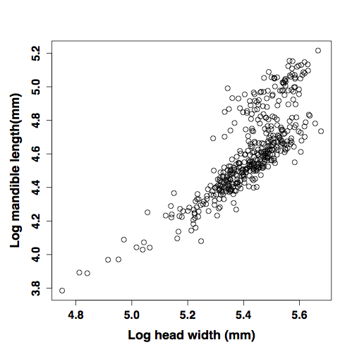
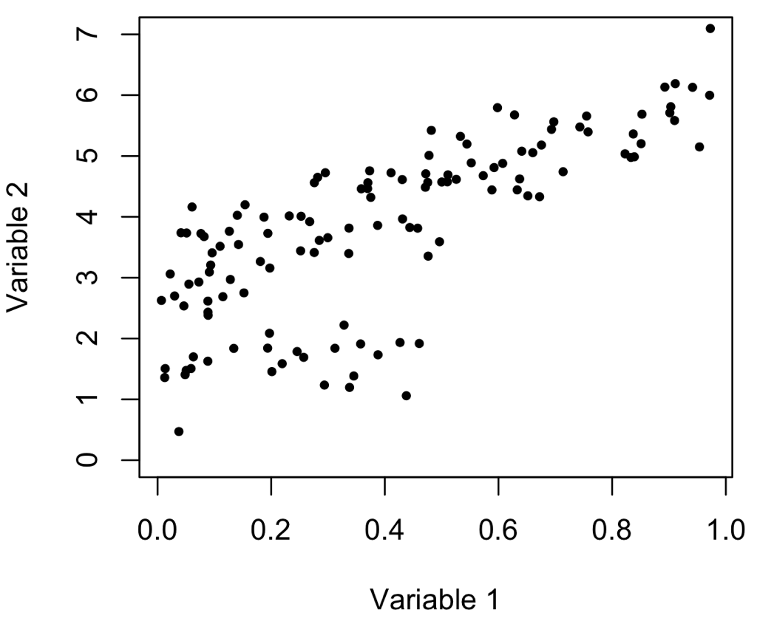
Scatter plots

Slide 46
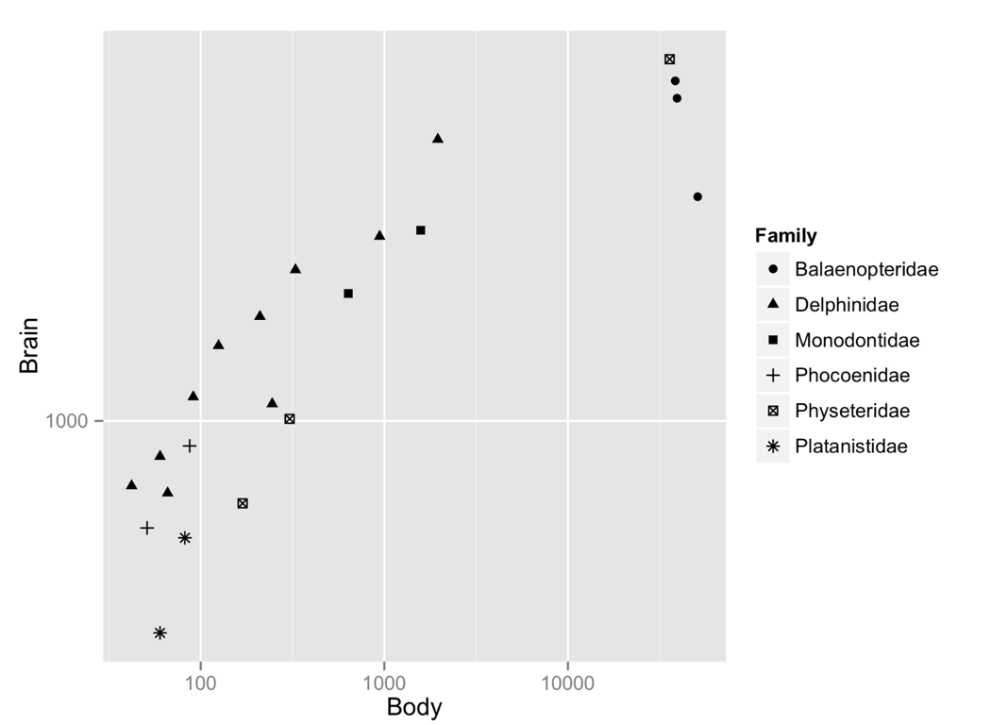
Scatter plots

Slide 47
Scatterplots
We can use scatterplots to:
See relationships between two variables
Check for non-linearity
Check for outliers and errors
Check for changes in variance
Check for structure in the data

Slide 48
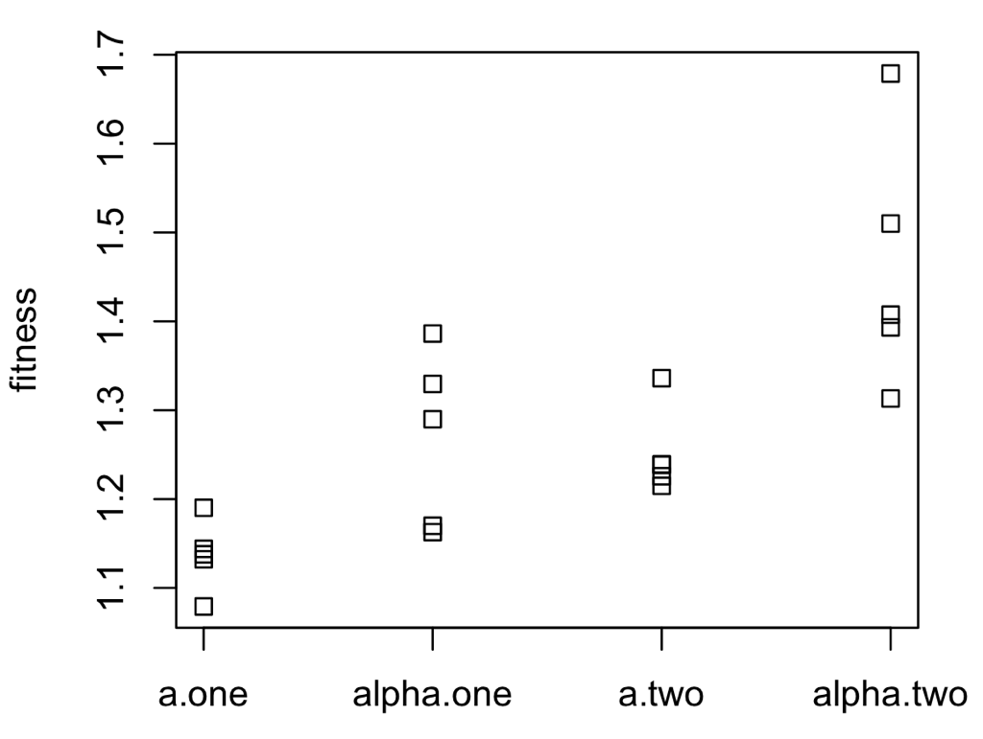
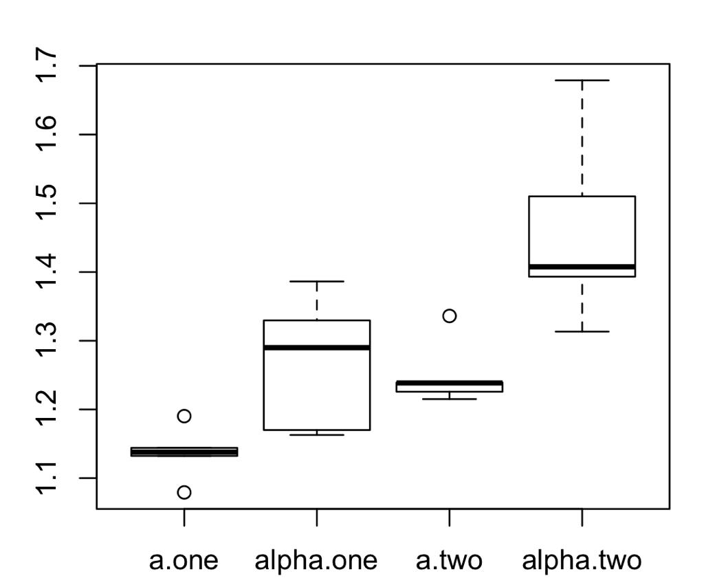
Stripplots and boxplots

Slide 49
Stripplots and boxplots
Use when you have one continuous variable and one categorical variable
Stripplots are less useful when n is high
Give an impression of how the continuous variable depends on the categorical
Allow you to identify outliers, errors and patterns in variance

Slide 50
Recap

